Slide 1

Nexus Bank Project
Capstone_Project 25 June 2023 (Henry Okeoma)

Slide 2
Project Outline
Problem Statement
Contents and Steps for Project
Methodology – EDA, Customer Segmentation and Predictive Models
Results
Conclusion and Recommendation

Slide 3
Problem Statement:
Our client is facing the challenge of low response rates to their marketing campaigns.
Identify patterns and trends in customer behavior
Anticipate future customer behavior and likelihood of subscription to term deposits
Effectiveness of campaign and customer response to campaigns in terms of deposits
Operation optimization risk mitigation and overall improvement to customer to term deposit subscription
What factors influence default among customer
TERM DEPOSIT: are a type of investment or savings product where individuals deposit a specific amount of money for a fixed period, known as the term or maturity period

Slide 4
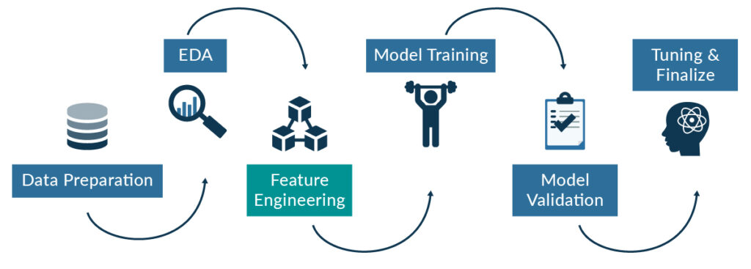
Contents/Steps
Data set details
Dimensionality (Rows = 45,211. Columns = 17)
Duplicated Values = Nil, Missing values = Nil,
Pdays as number of days had some negative values, which was change to positive
Age_Bracket Feature was created to aid our data analysis
EDA – Univariate, Bivariate and Multivariate Analysis
Unsupervised Machine Learning – Kmeans method
Supervised Machine Learning – with target as ‘deposit’
Feature importance

Slide 5
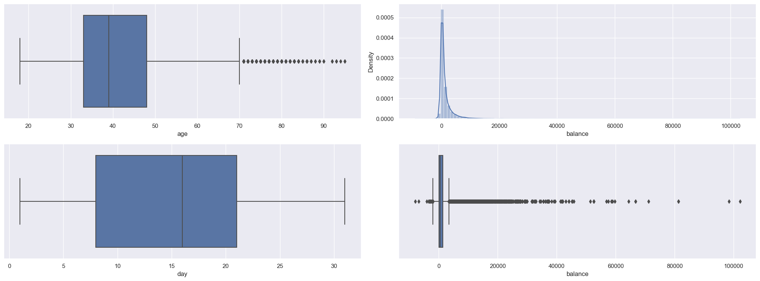
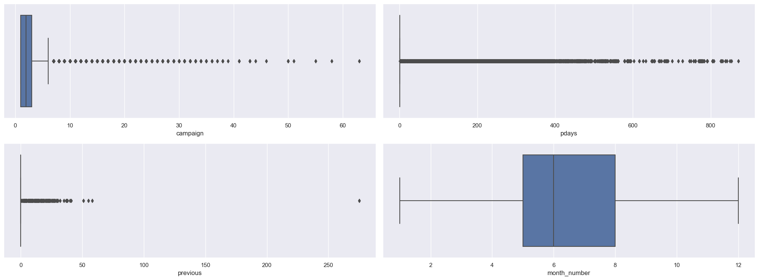
EDA - Univariate Analysis of Numerical Columns

Slide 6
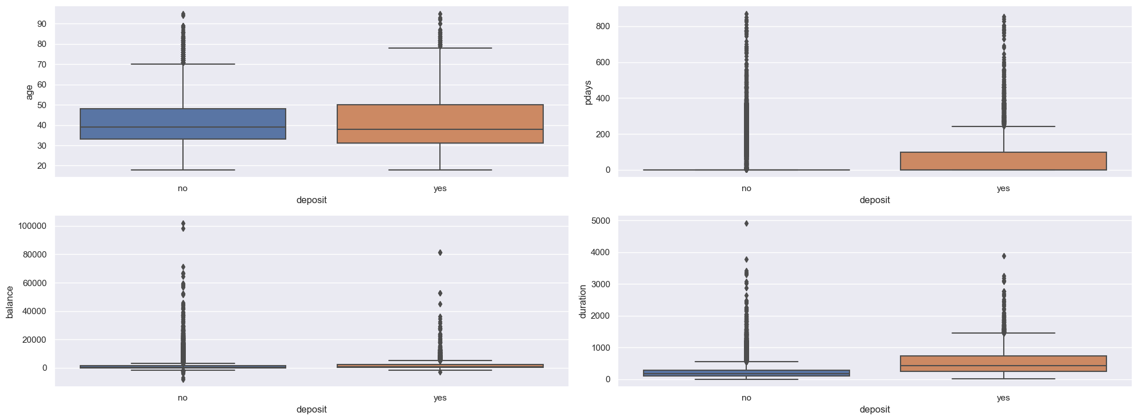
EDA - Bivariate Analysis of Numerical Columns

Slide 7
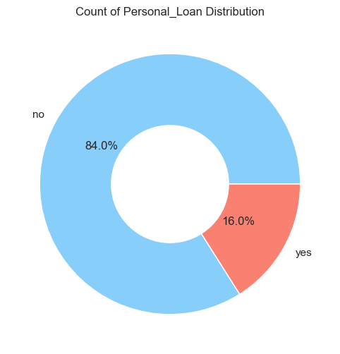
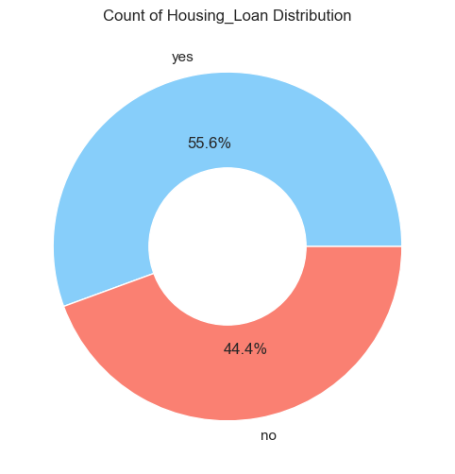
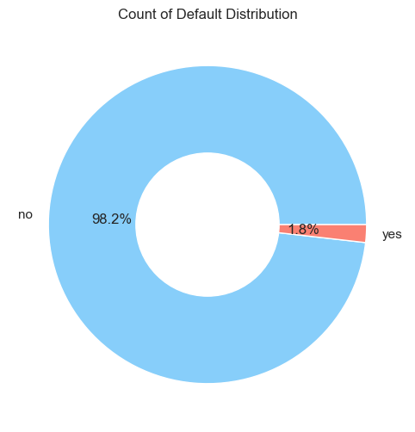
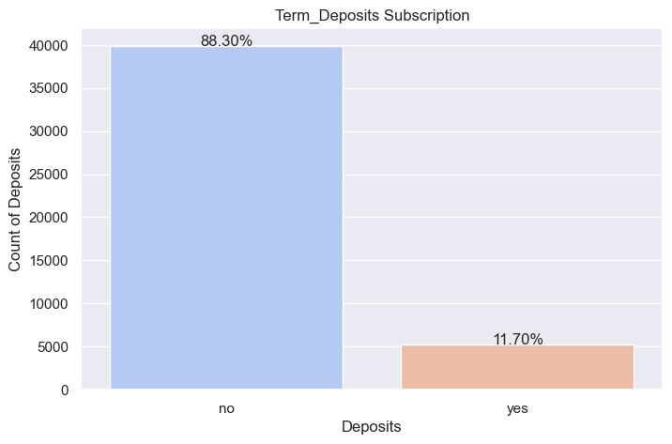
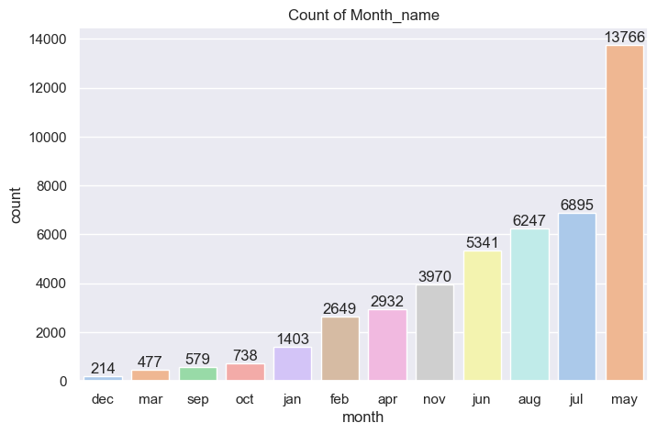
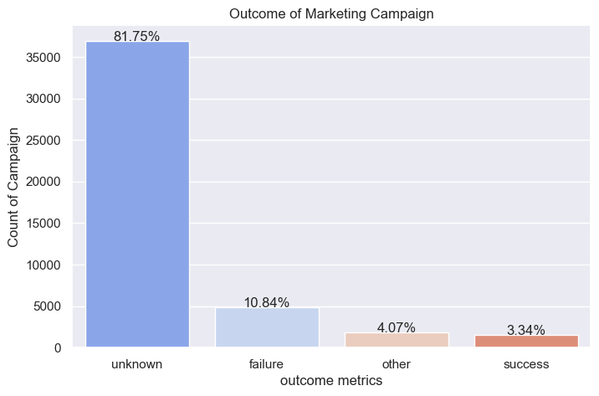
EDA - Univariate Analysis of Categorical Columns

Slide 8
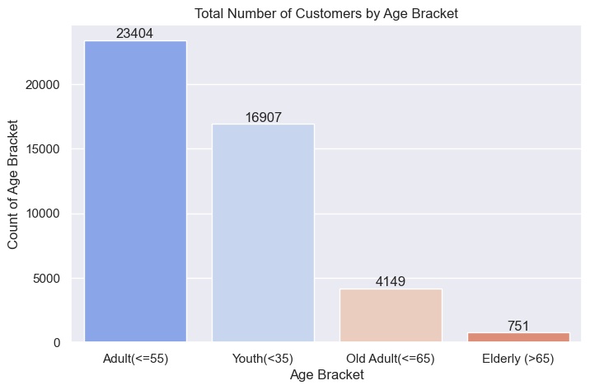
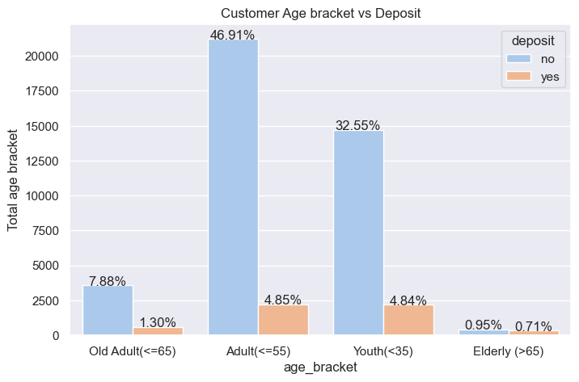
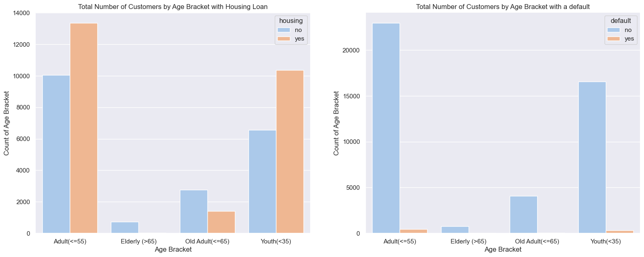
EDA – Univariate/Bivariate/Univariate Analysis of Categorical Columns
Adults(<55yrs) and Youths(<35yrs) have the most defaults

Slide 9
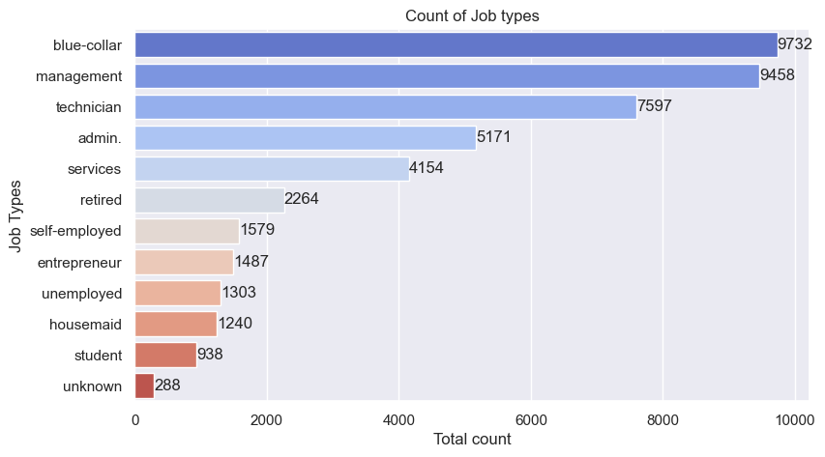
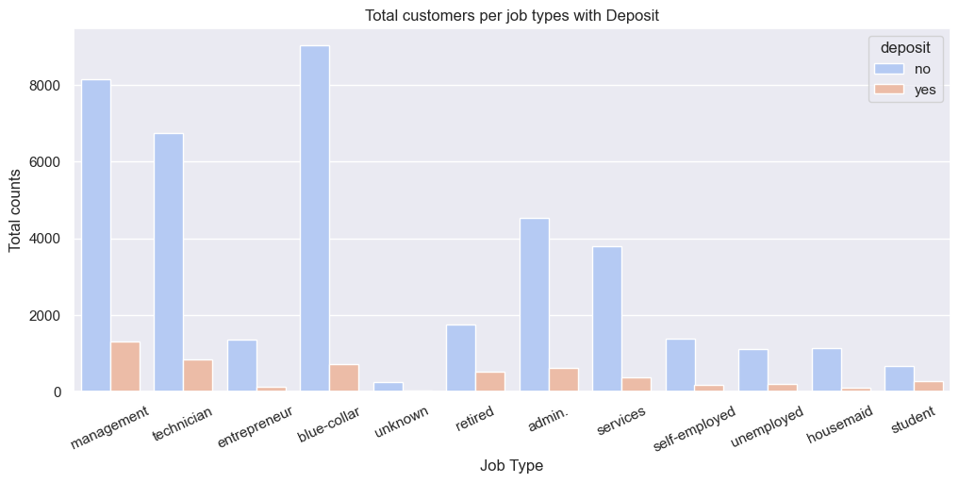
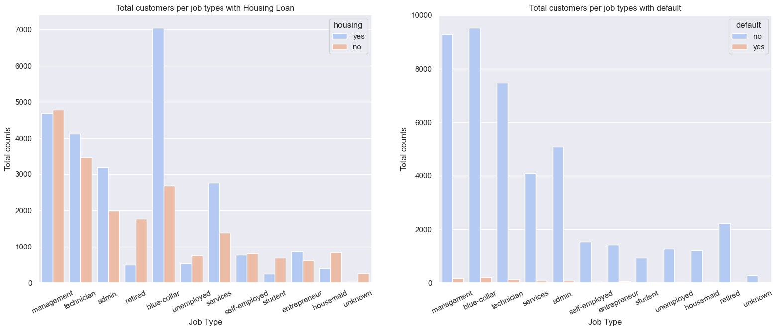
EDA – Univariate/Bivariate/Univariate Analysis of Categorical Columns
Students and retired customer have the most deposit by proportion.
Unemployed, blue-collar and Entrepreneurs are most defaulters

Slide 10
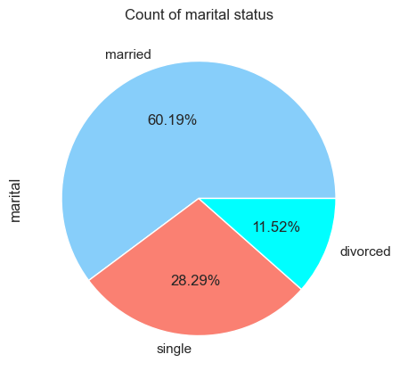
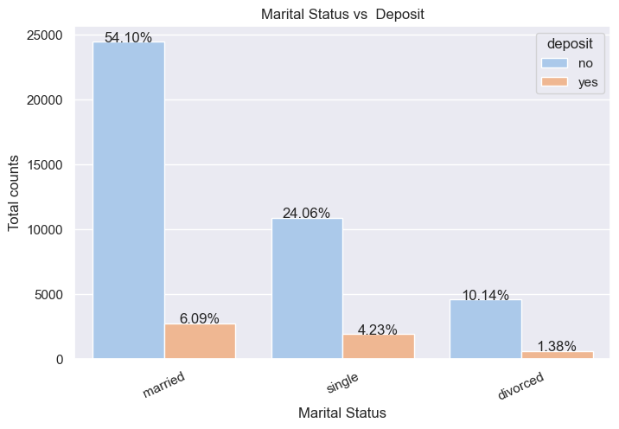
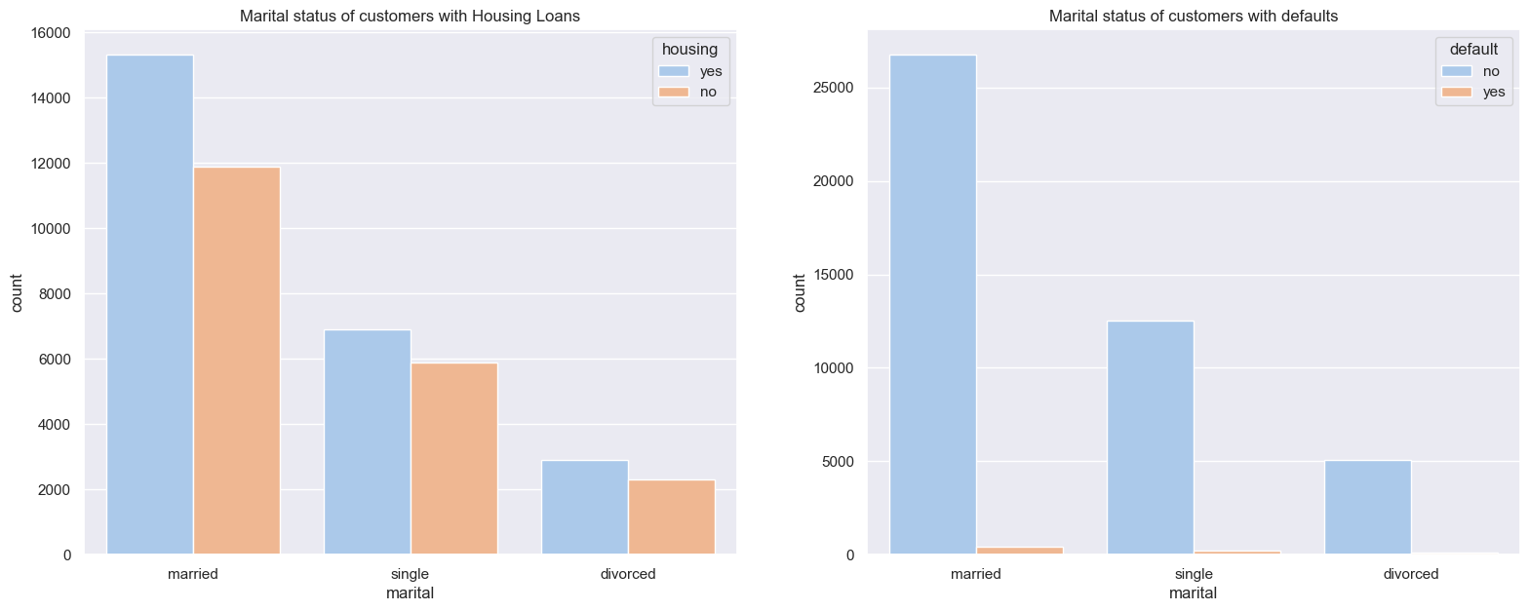
EDA – Univariate/Bivariate/Univariate Analysis of Categorical Columns
Single customer subscribe more to term deposits by proportion
Divorced customers have the highest default number by proportion

Slide 11
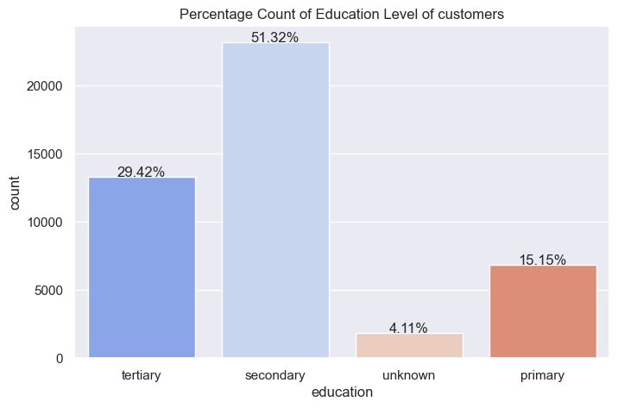
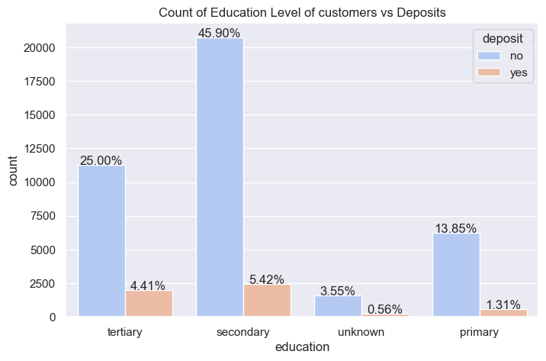
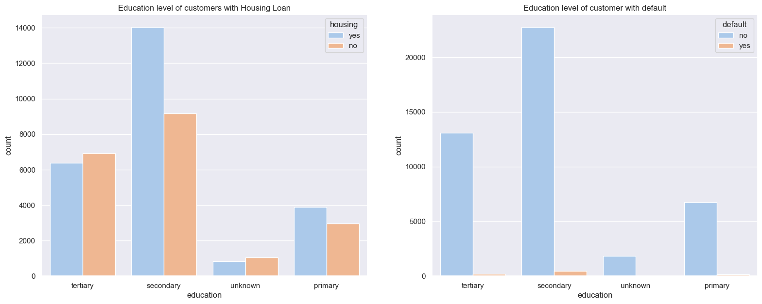
EDA – Univariate/Bivariate/Univariate Analysis of Categorical Columns
On deposits, tertiary and unknown group subscribe more to term deposits.
On the housing Loan default, , secondary education have the highest default rate

Slide 12
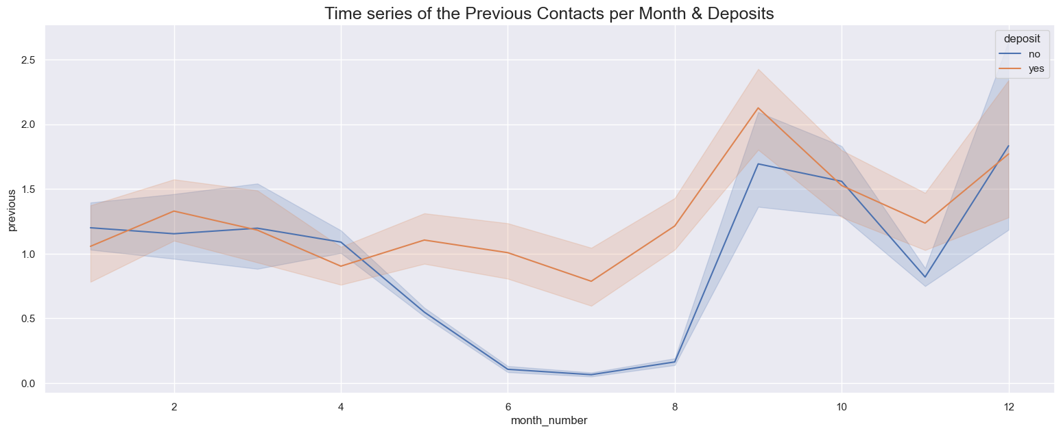
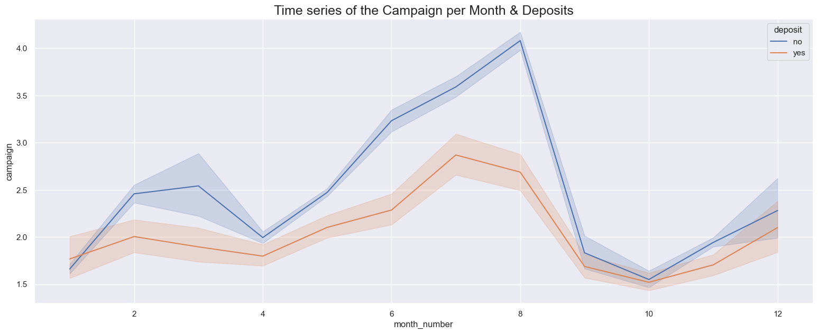
Bivariate Analysis and Multivariate Analysis
With focus on Term Deposits (as Deposits), Focus on Loan Defaulting, With Focus on Campaigns contacts and Previous contacts and its relationship to Deposits

Slide 13
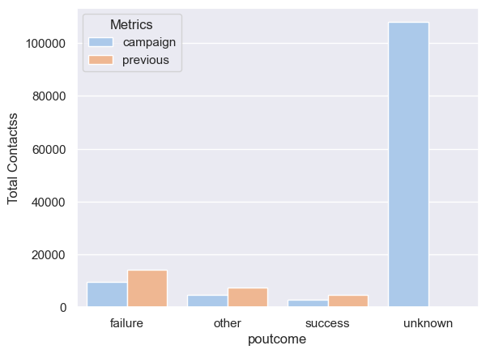
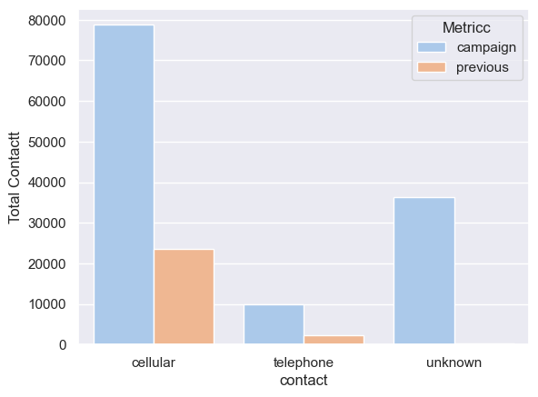
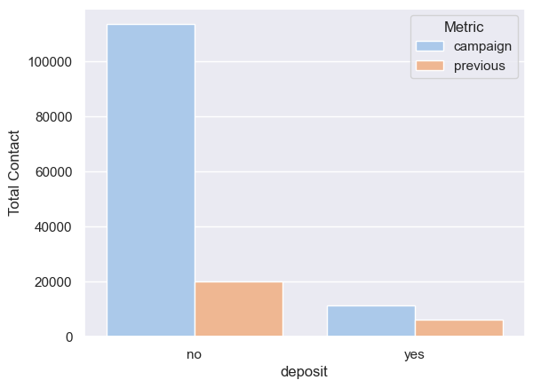
Bivariate Analysis and Multivariate Analysis/ Campaign Outcomes and Contacts Used
With focus on Term Deposits (as Deposits), Focus on Loan Defaulting, With Focus on Campaigns contacts and Previous contacts and its relationship to Deposits

Slide 14
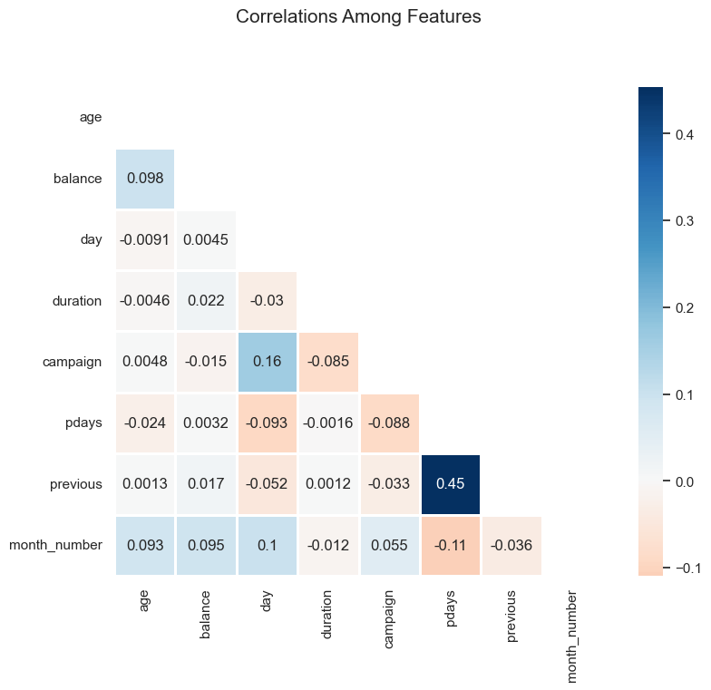
Correlation of Numerical Features

Slide 15
EDA Insights
Who are the Customers with the Least Deposit by proportion? These are those Customers who should be the Target for Fixed Deposit as regards to Next Campaigns
We identified them as follows,
Age Bracket: The adults and the Youths (0 - 55yrs) customer make up a high number of customers, but on the contrary, the contribute least proportion wise to the deposits, hence these are the people marketting campaigns should be targeted towards.
we can also say that old adults and elderly are most interested in deposits
Job- Type: Blue-collar, Entreprenuer and services have the least deposit by their total counts and should also included in the target for campaign
Marital: Married customers have the least deposits compared to their total count and they should also be target for campaigns
Education: Customer with secondary education should also be targeted for campaign on term deposits as they make up a high number and least in term deposits

Slide 16
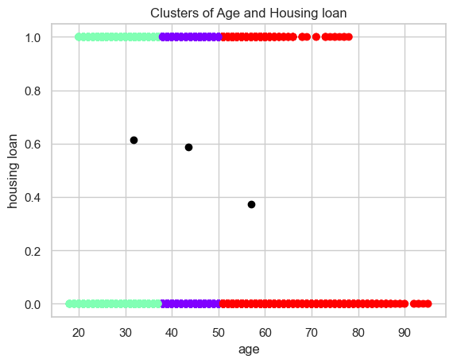
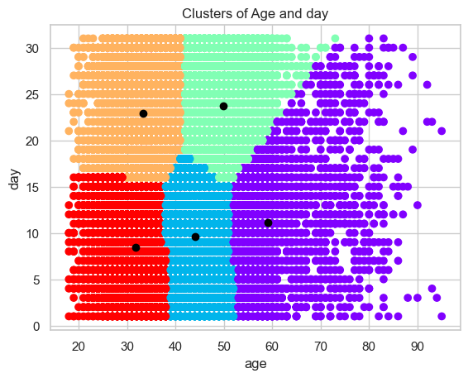
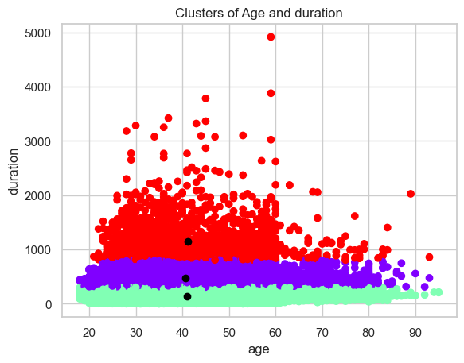
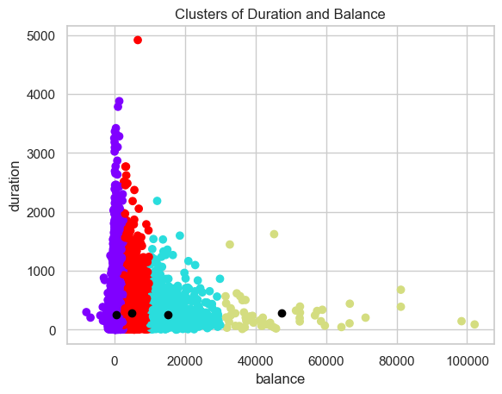
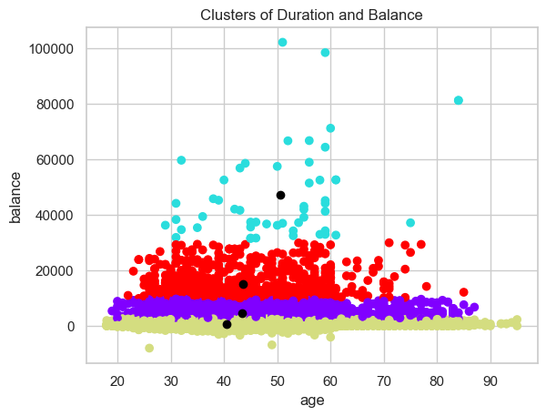
Unsupervised Machine Learning - Using Elbow methond & K-means and Label encoder to change to Numericals
silhouette_score = 56%
silhouette_score = 37%
silhouette_score = 64%
silhouette_score = 74%
silhouette_score = 76%

Slide 17
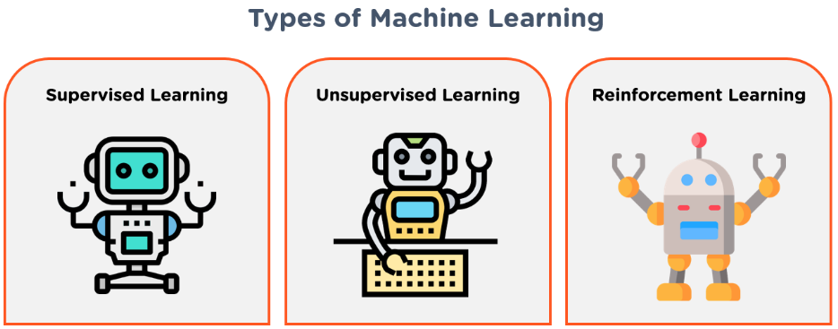
Supervised Machine Learning. Target is Term Deposits (as deposit)
Feature Engineering – select the features required for our machine learning to avoid overfitting/underfitting
drop the target (dependent variable)
Encoding – Label encoding to change the categorical features selected above to numerical required for ML
Data Normalisation – using min-max scaler to scale all number to be between 0 and 1 for our binary classification.
Using the Scikit-learn Libraries, our data was split into 80% training as X and 20% testing as y
But our target variable is imbalance
We applied SMOTE
before SMOTE : Counter({0: 31970, 1: 4198})
After SMOTE : Counter({0: 31970, 1: 31970})
Synthetic Minority Oversampling Technique (SMOTE) is a statistical technique for increasing the number of cases in your dataset in a balanced way

Slide 18
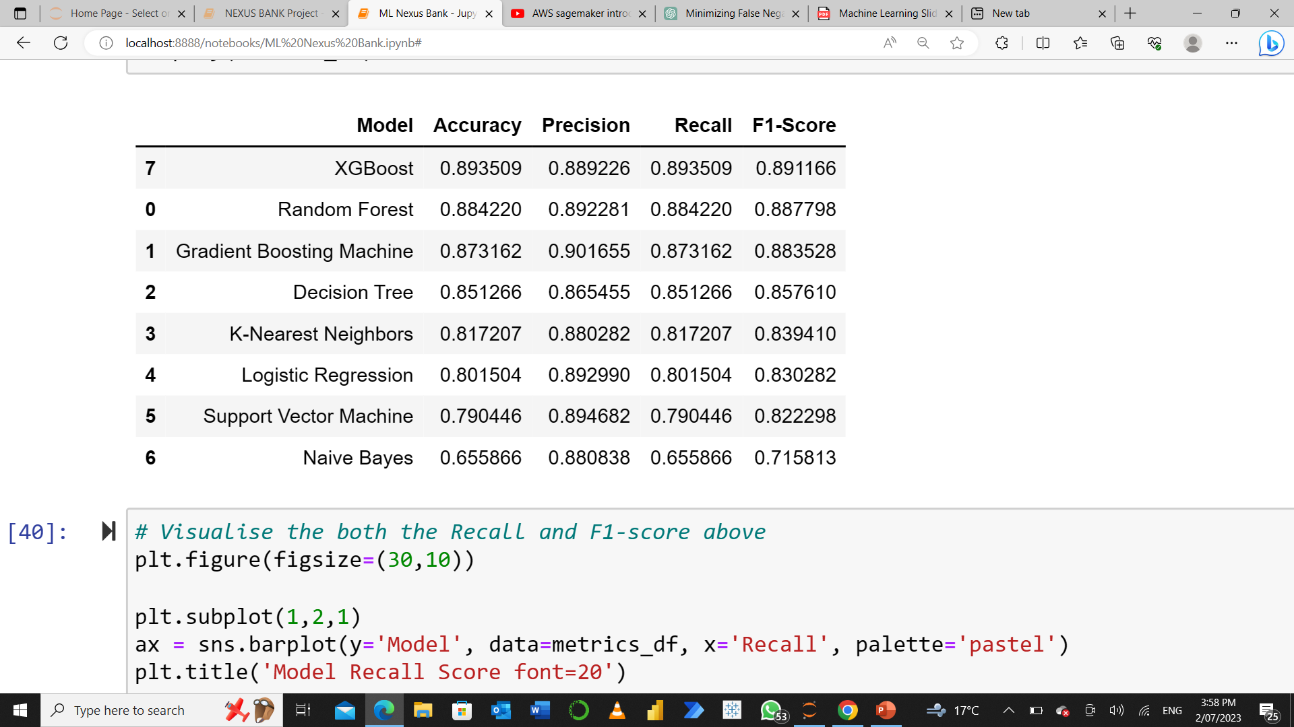
Supervised Machine Learning. Results
classifiers = [("Decision Tree"), "K-Nearest Neighbors"), "Support Vector Machine"),
"Logistic Regression"), "Random Forest"), "Naive Bayes"),
"Gradient Boosting Machine"),"XGBoost")]
Recall is more important to us, as this measures the lowest False Negatives values. XGBoost has the highest recall score of 89.4%, indicating a low rate of false negatives.
F1-score provides a balanced measure of both precision and recall. XGBoost achieves the highest F1-score of 89.1%, indicating a good balance between precision and recall.
Considering all the metrics, XGBoost consistently performs well across accuracy, precision, recall, and F1-score. Therefore,, XGBoost seems to be the best predictive model for the classification task of determining whether a customer will subscribe to a term deposit or not.

Slide 19
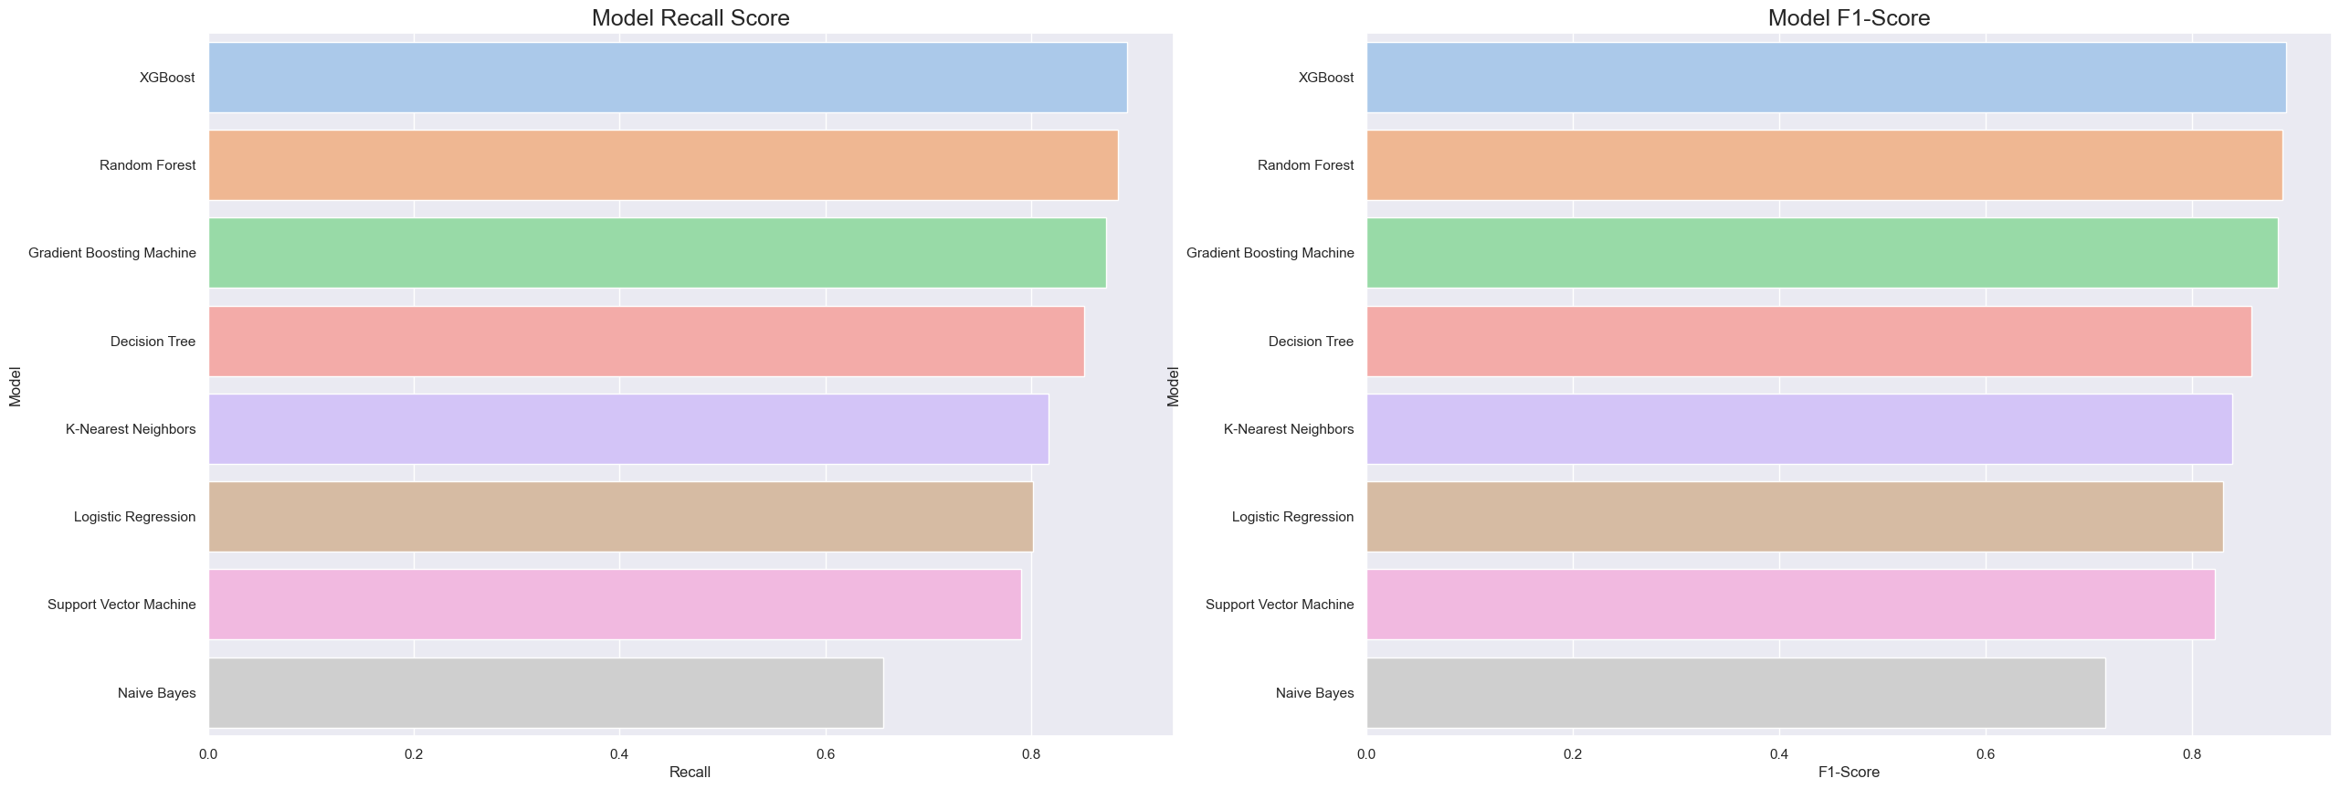
Supervised Machine Learning. Results
Visualization of the Model performance ascending = False for

Slide 20
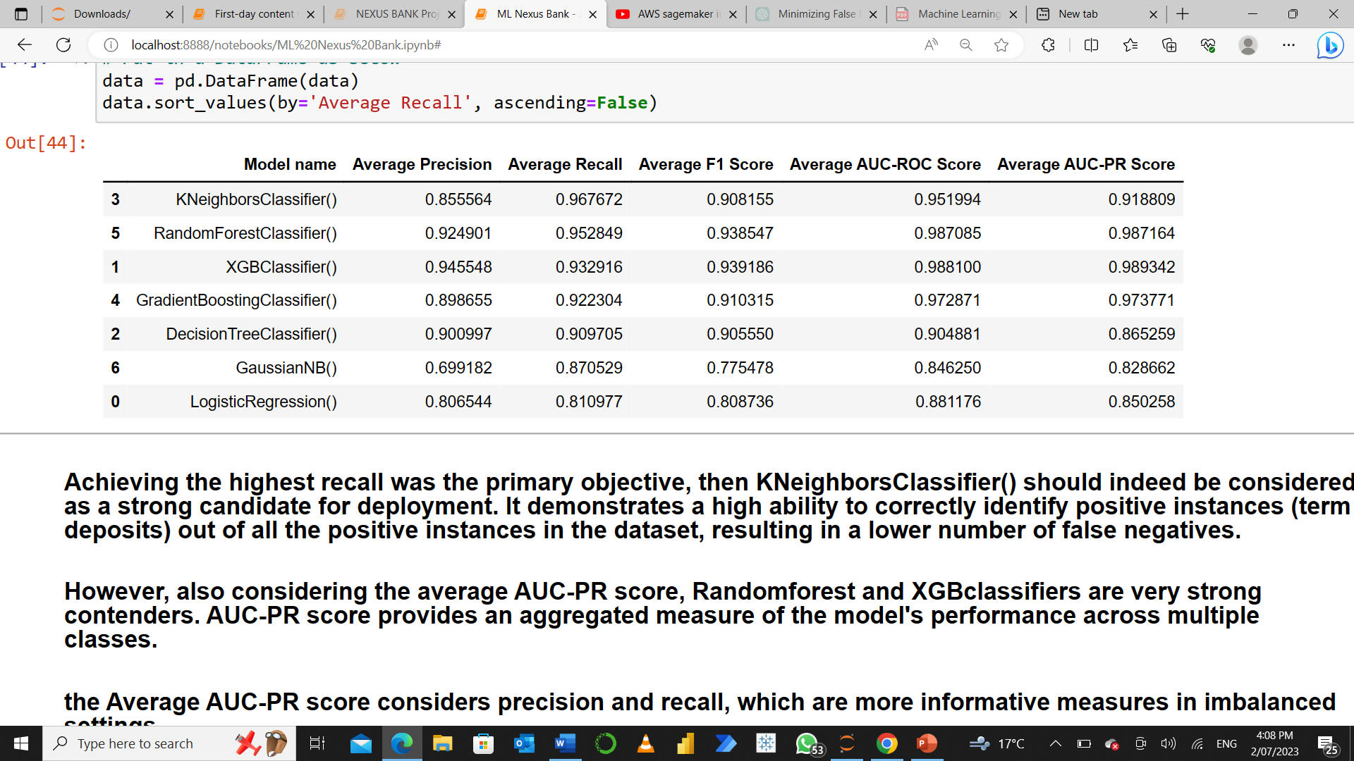
Cross Validation Kfold K = 10.
classifiers = [("Decision Tree"), "K-Nearest Neighbors"), "Support Vector Machine"),
"Logistic Regression"), "Random Forest"), "Naive Bayes"),
"Gradient Boosting Machine"),"XGBoost")]
Achieving the highest recall was the primary objective, then KNeighborsClassifier() should indeed be considered as a strong candidate for deployment. It demonstrates a high ability to correctly identify positive instances (term deposits) out of all the positive instances in the dataset, resulting in a lower number of false negatives.
However, also considering the average AUC-PR score, Randomforest and XGBclassifiers are very strong contenders. AUC-PR score provides an aggregated measure of the model's performance across multiple classes.
the Average AUC-PR score considers precision and recall, which are more informative measures in imbalanced settings.
In summary, the Average AUC-PR score as a metric that quantifies the performance of a binary classification model in handling class imbalance by measuring the model's ability to rank positive instances higher than negative instances across various classification thresholds; we shall then propose the XGBclassifier or the ramdomforest_classifier as the best in this classification task and therefore either or should be deployed.

Slide 21
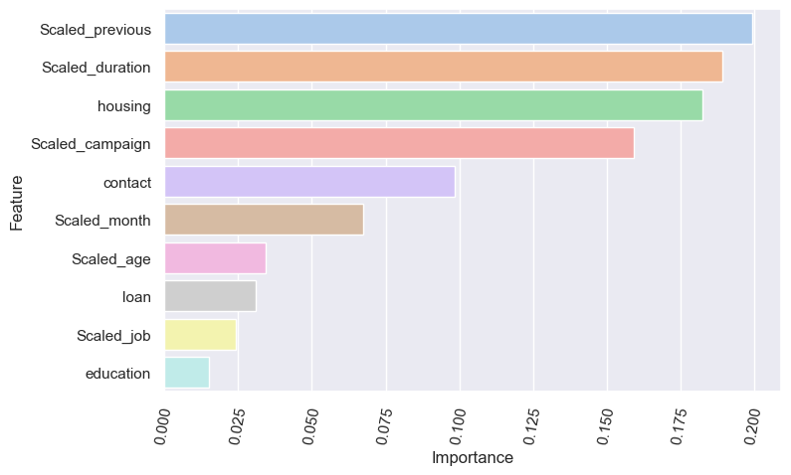
Feature Importance
Our previous contact, duration, housing, campaign and contact were more important in our model building.

Slide 22
Conclusion and Recommendations
The Purpose of this project was to segment customers for campaign targets, identify customer types with the highest defaults and build a machine learning model to predict term deposit in nexus bank.
We have previously established our insights from EDA and identified the customers that should be targeted for campaigns
We further segmented the customers on page16 defining their behavior and insights from there will guide the marketing team to be specific in their campaigns
We propose deployment of our machine learning models using the XGBoost classifier or the RandomForest as the best performing model having the highest recall as well as the accuracy, precision and F1-score.
Thank You!!!.
Henry Okeoma

